Slide 1
PMCA502L – Java Programming
Exception Handling & Multithreading
Exception Handling – Keywords – Built-in Exceptions – User Defined Exceptions, Multithreading – The Lifecycle of a Thread – Thread Creation using Thread Class and Runnable Interface – Synchronization – Inter – Thread Communication.

Slide 2
Exception
An exception (or exceptional event) is a problem that arises during the execution of a program. When an Exception occurs the normal flow of the program is disrupted and the program/Application terminates abnormally. The core advantage of exception handling is to maintain the normal flow of the application.
An exception can occur due to:
A user has entered an invalid data.
A file that needs to be opened cannot be found.
A network connection has been lost in the middle of communications or the JVM has run out of memory.

Slide 3
Normal Flow vs. Exception Handled Flow
statement 1;
statement 2;
statement 3;
statement 4;
statement 5;
statement 6;
statement 7;
statement 8;
statement 9;
statement 10;
statement 1;
statement 2;
statement 3;
statement 4;
statement 5;
statement 6;
statement 7;
statement 8;
statement 9;
statement 10;
exception occurs
Handle Exception

Slide 4
Exception Types
Some exceptions are caused by user error, others by programmer error, and others by physical resources that have failed in some manner.
Based on these, Exceptions are categorized into three types:
Checked Exceptions
UnChecked Exceptions
Errors

Slide 5
Checked Exception
Checked exceptions: A checked exception is an exception that occurs at the compile time, these are also called as compile time exceptions. These exceptions cannot simply be ignored at the time of compilation, the programmer should take care of (handle) these exceptions.
For example, if you use FileReader class in your program to read data from a file, if the file specified in its constructor doesn't exist, then a FileNotFoundException occurs, and the compiler prompts the programmer to handle the exception.

Slide 6
Unchecked Exception
Unchecked exceptions: An unchecked exception is an exception that occurs at the time of execution. These are also called as Runtime Exceptions. These include programming bugs, such as logic errors or improper use of an API. Runtime exceptions are ignored at the time of compilation.
For example, if you have declared an array of size 5 in your program, and trying to call the 6th element of the array then an ArrayIndexOutOfBoundsExceptionexception occurs.

Slide 7
Errors
Errors: These are not exceptions at all, but problems that arise beyond the control of the user or the programmer. Errors are typically ignored in your code because you can rarely do anything about an error. For example, if a stack overflow occurs, an error will arise. They are also ignored at the time of compilation.

Slide 8
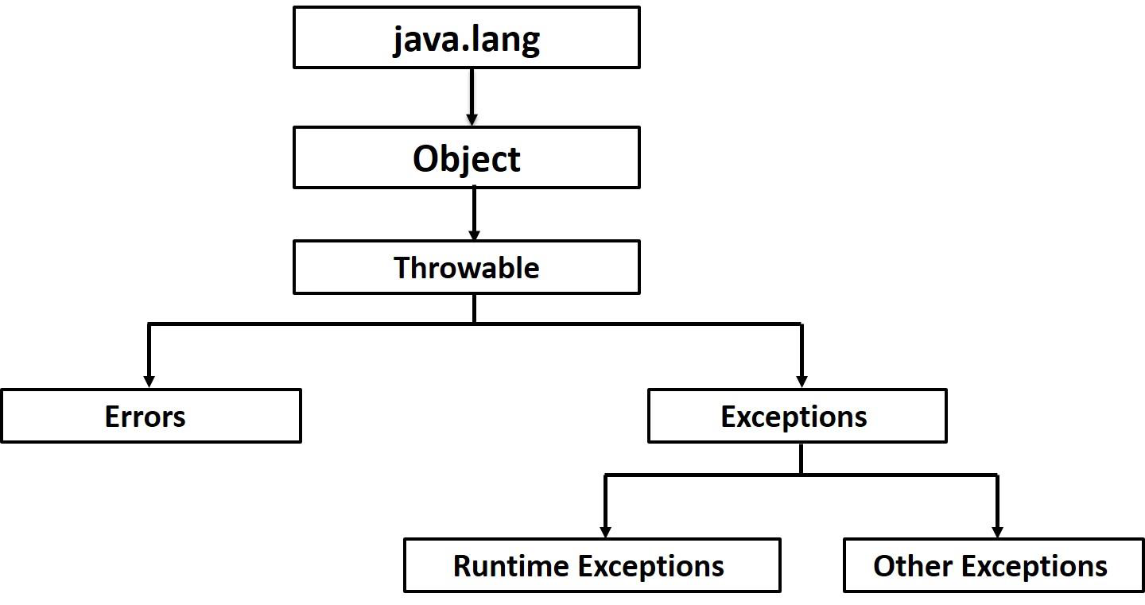
Exception Hierarchy
All exception classes are subtypes of the java.lang.Exception class. The Exception class has two main subclasses: IOException class and RuntimeException Class.

Slide 9
Built-in Exceptions
Java defines several exception classes inside the standard package java.lang. The most general of these exceptions are subclasses of the standard type RuntimeException. Since java.lang is implicitly imported into all Java programs, most exceptions derived from RuntimeException are automatically available.

Slide 10
Unchecked Runtime Exception
Exception | Description
ArithmeticException | Arithmetic error, such as divide-by-zero.
ArrayIndexOutOfBoundsException | Array index is out-of-bounds.
IllegalArgumentException | Illegal argument used to invoke a method.
IndexOutOfBoundsException | Some type of index is out-of-bounds.
NegativeArraySizeException | Array created with a negative size.
NullPointerException | Invalid use of a null reference.
NumberFormatException | Invalid conversion of a string to a numeric format.
StringIndexOutOfBounds | Attempt to index outside the bounds of a string.

Slide 11
Checked Exception
Exception | Description
ClassNotFoundException | Class not found.
IllegalAccessException | Access to a class is denied.
InstantiationException | Attempt to create an object of an abstract class or interface.
NoSuchFieldException | A requested field does not exist.
NoSuchMethodException | A requested method does not exist.

Slide 12
Exception
Java provides five keywords that are used to handle the exception.
Keyword | Description
try | The "try" keyword is used to specify a block where we should place an exception code. It means we can't use try block alone. The try block must be followed by either catch or finally.
catch | The "catch" block is used to handle the exception. It must be preceded by try block which means we can't use catch block alone. It can be followed by finally block later.
finally | The "finally" block is used to execute the necessary code of the program. It is executed whether an exception is handled or not.
throw | The "throw" keyword is used to throw an exception.
throws | The "throws" keyword is used to declare exceptions. It specifies that there may occur an exception in the method. It doesn't throw an exception. It is always used with method signature.

Slide 13
Try – Catch Block
A method catches an exception using a combination of the try and catch keywords.
A try/catch block is placed around the code that might generate an exception. Code within a try/catch block is referred to as protected code.
Syntax for using try/catch looks like the following:
try {
//Protected code
}catch(ExceptionName e1) {
//Catch block
}

Slide 14
Try – Catch Block
The code which is prone to exceptions is placed in the try block. When an exception occurs, that exception occurred is handled by catch block associated with it. Every try block should be immediately followed either by a catch block or finally block.
A catch statement involves declaring the type of exception you are trying to catch. If an exception occurs in protected code, the catch block (or blocks) that follows the try is checked. If the type of exception that occurred is listed in a catch block, the exception is passed to the catch block much as an argument is passed into a method parameter. An exception (or exceptional event) is a problem that arises during the execution

Slide 15
Exception Example
The following is an array declared with 2 elements. Then the code tries to access the 3rd element of the array which throws an exception.
import java.io.*;
public class ExcepTest {
public static void main(String args[]) {
int a[] = new int[2];
try{
System.out.println("Access element three :" + a[3]);
System.out.println(“After accessing array”);
} catch(ArrayIndexOutOfBoundsException e) {
System.out.println("Exception thrown :" + e);
}
System.out.println("Out of the block");
}
}
Exception thrown java.lang.ArrayIndexOutOfBoundsException: 3
Out of the block

Slide 16
Exception – Multiple Catch Blocks
A try block can be followed by multiple catch blocks. The syntax for multiple catch blocks looks like the following:
This example demonstrates three catch blocks, but can have any number of them after a single try.
If an exception occurs in the protected code, the exception is thrown to the first catch block in the list.
If the data type of the exception thrown matches ExceptionType1, it gets caught there. If not, the exception passes down to the second catch statement. This continues until the exception either is caught or falls through all catches
try
{
//Protected code
}catch(ExceptionType1 e1) {
//Catch block 1
}catch(ExceptionType2 e2) {
//Catch block 2
}catch(ExceptionType3 e3) {
//Catch block 3
}

Slide 17
Exception – finally block
The finally block follows a try block or a catch block. A finally block of code always executes, irrespective of occurrence of an Exception.
Using a finally block allows you to run any cleanup-type statements that you want to execute, no matter what happens in the protected code.
A finally block appears at the end of the catch blocks and has the syntax →
try
{
//Protected code
}catch(ExceptionType1 e1) {
//Catch block 1
}catch(ExceptionType2 e2) {
//Catch block 2
}catch(ExceptionType3 e3) {
//Catch block 3
} finally {
// always the finally block executes
}

Slide 18
Finally Example
public class ExcepTest {
public static void main(String args[]) {
int a[] = new int[2];
try {
System.out.println("Access element three :" + a[3]);
} catch(ArrayIndexOutOfBoundsException e) {
System.out.println("Exception thrown :" + e);
} finally {
a[0] = 6;
System.out.println("First element value: " +a[0]);
System.out.println("The finally statement is executed"); }
}
}
Output:
Exception thrown :java.lang.ArrayIndexOutOfBoundsException: 3
First element value: 6
The finally statement is executed

Slide 19
Exception - Throw
The throw keyword in Java is used to explicitly throw an exception from a method or any block of code.
Can throw either checked or unchecked exception.
The throw keyword is mainly used to throw custom exceptions.
try
{
//Protected code
if (cond) throw new exceptionType1(parameter);
}catch(ExceptionType1 e1) {
//Catch block 1
}

Slide 20
Exception – Throw
import java.io.*; import java.util.Scanner;
public class ExcepTest2 {
public static void main(String args[]) {
int a[] = {1,2,3,4,5,6,7,8,9,10};
Scanner inp = new Scanner(System.in);
System.out.println("Enter a value(3-6)");
int i =inp.nextInt();
try{
if (i<3 || i >6)
throw new ArrayIndexOutOfBoundsException("index range is out of size");
System.out.println("Access element three :" + a[i]);
} catch(ArrayIndexOutOfBoundsException e) {
System.out.println("Exception thrown :" + e);
}
}
}
Enter a value(3-6)
7
Exception thrown :java.lang.ArrayIndexOutOfBoundsException: index range is out of size

Slide 21
Exception – Throws
If a method does not handle a checked exception, the method must declare it using the throws keyword.
The throws keyword appears at the end of a method's signature.
You can throw an exception, either a newly instantiated one or an exception that you just caught, by using the throw keyword.
Try to understand the difference between throws and throw keywords, throws is used to postpone the handling of a checked exception and throw is used to invoke an exception explicitly.
import java.io.*;
public class className {
public void deposit(double amount) throws IOException
{
// Method implementation
throw new IOException(); }
//Remainder of class definition }

Slide 22
Exception – Throws Example
// Java program to illustrate error in case of unhandled exception
class tst
{
public static void main(String[] args)
{
Thread.sleep(10000);
System.out.println("Hello Geeks");
}
}
// Java program to illustrate throws
class tst
{
public static void main(String[] args) throws InterruptedException
{
Thread.sleep(10000);
System.out.println("Hello Geeks");
}
}
Output:
error: unreported exception InterruptedException; must be caught or declared to be thrown
Output:
Hello Geeks

Slide 23
Exception – Throws
// Java program to demonstrate working of throws
class ThrowsExecp
{
static void fun() throws IllegalAccessException
{
System.out.println("Inside fun(). ");
throw new IllegalAccessException("demo");
}
public static void main(String args[])
{
try
{
fun();
}
catch(IllegalAccessException e)
{
System.out.println("caught in main.");
}
System.out.println(“rest of the code”);
}
}
Output:
Inside fun().
caught in main
rest of the code

Slide 24
User Defined Exception
In Java, we can create our own exceptions that are derived classes of the Exception class.
Basically, Java custom exceptions are used to customize the exception according to user need.
Using the custom exception, we can have your own exception and message.
Here, we have passed a string to the constructor of superclass i.e. Exception class that can be obtained using getMessage() or toString() method on the object we have created.
To catch and provide specific treatment to a subset of existing Java exceptions.
Business logic exceptions: These are the exceptions related to business logic and workflow.

Slide 25
User Defined Exception
Explicit User-defined exception
class MyException extends Exception {
String errMessage;
public MyException(String s) {
// assign error message
errMessage = s; }
public String toString() {
return(errMessage); }
//or
public String getMessage() {
return(errMessage); }
}
Implicit User-defined exception
class MyException extends Exception {
String errMessage;
public MyException(String s) {
// calls super class constructor
super(s); }
}

Slide 26
User Defined Exception
// A Class that represents use-defined expception
class MyException extends Exception {
String errMessage;
public MyException(String s) {
// assign error message
errMessage = s; }
public String toString() {
return(errMessage); }
}
// A Class that uses above MyException
public class Main {
public static void main(String args[]) {
try {
// Throw an object of user defined exception
throw new MyException(“Error message - GeeksGeeks");
} catch (MyException ex) {
// Print the message from MyException object
System.out.println(ex.getMessage()); }
}
}
Output:
Error message - GeeksGeeks

Slide 27
References
www.javatpoint.com
www.javatutorialspoint.com
www.geeksforgeeks.com
https://techvidvan.com/tutorials/java-installation/
https://www.oracle.com/java/technologies/javase-jdk16-downloads.html
Herbert Schildt, The Complete Reference -Java, Tata McGraw-Hill Education, Tenth Edition, 2017.
Vijayarani A., AP SITE, VIT, Vellore

